Slide 1

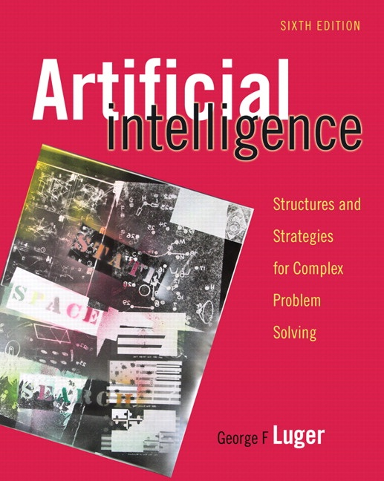
Building Control Algorithms For State Space Search.
5.0 Introduction
5.1 Recursion-Based Search
5.2 Production Systems
5.3 The Blackboard Architecture for Problem Solving
5.4 Epilogue and References
5.5 Exercises
George F Luger
ARTIFICIAL INTELLIGENCE 6th edition
Structures and Strategies for Complex Problem Solving
Luger: Artificial Intelligence, 6th edition. © Pearson Education Limited, 2009
1

Slide 2
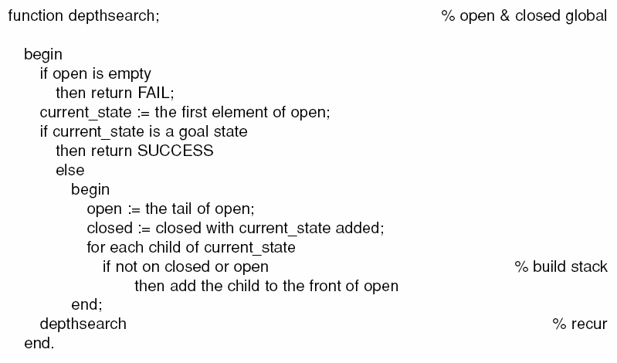
Luger: Artificial Intelligence, 6th edition. © Pearson Education Limited, 2009
2

Slide 3
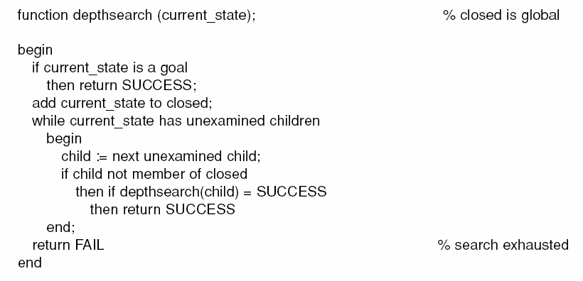
Luger: Artificial Intelligence, 6th edition. © Pearson Education Limited, 2009
3

Slide 4
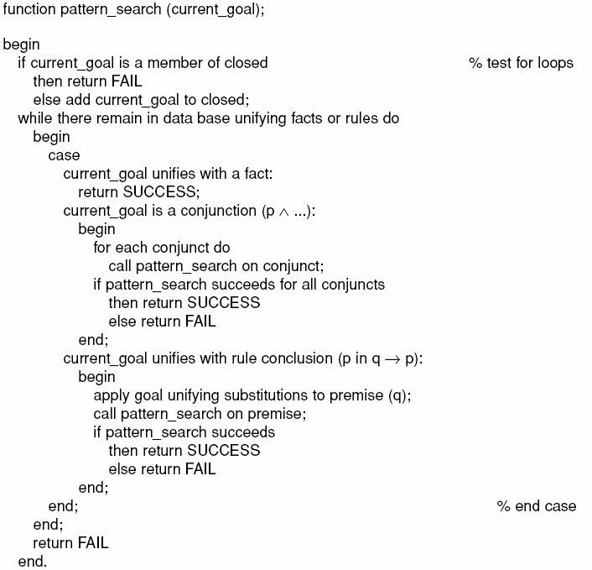
Luger: Artificial Intelligence, 6th edition. © Pearson Education Limited, 2009
4

Slide 5
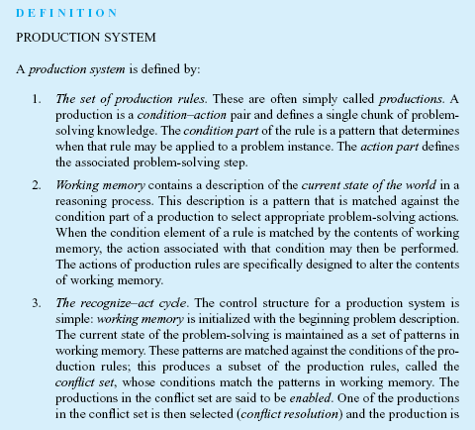
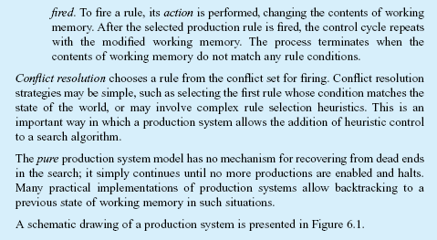
Luger: Artificial Intelligence, 6th edition. © Pearson Education Limited, 2009
5

Slide 6
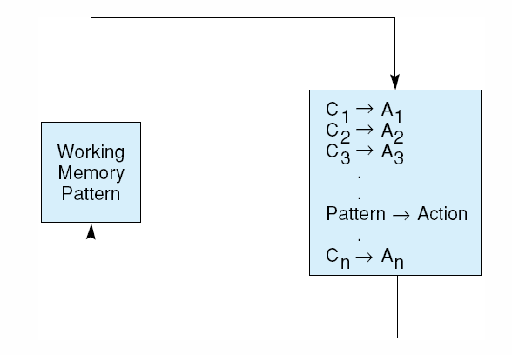
Fig 6.1 A production system. Control loops until working memory pattern no longer matches the conditions of any productions.
Luger: Artificial Intelligence, 6th edition. © Pearson Education Limited, 2009
6

Slide 7
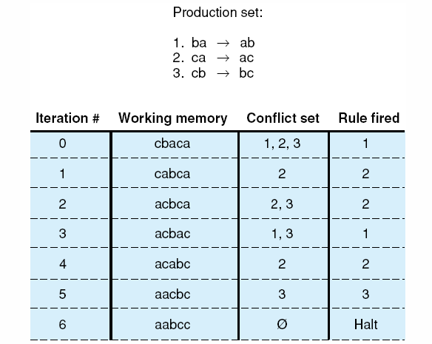
Fig 6.2 Trace of a simple production system.
Luger: Artificial Intelligence, 6th edition. © Pearson Education Limited, 2009
7

Slide 8
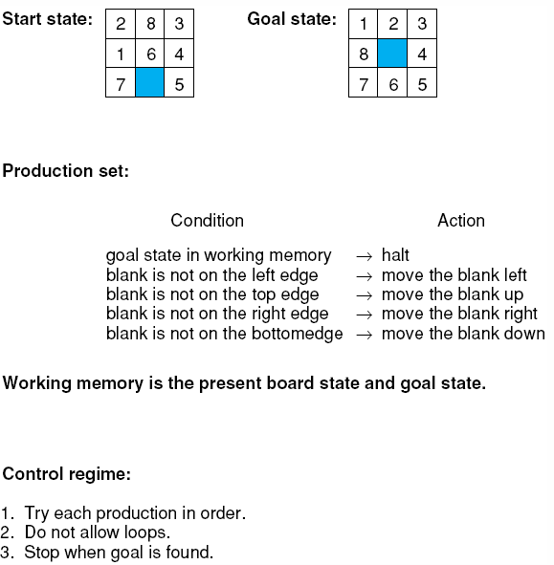
Fig 6.3 The 8-puzzle as a production system.
Luger: Artificial Intelligence, 6th edition. © Pearson Education Limited, 2009
8

Slide 9
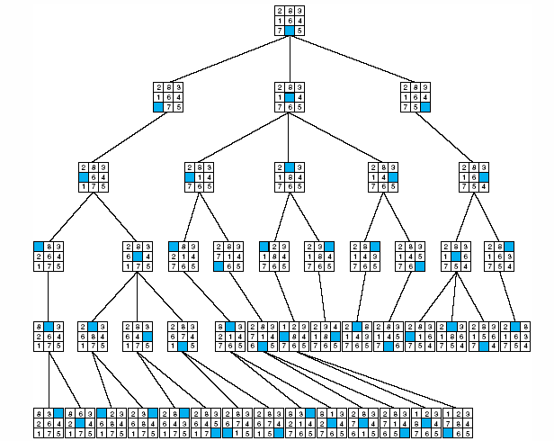
Fig 6.4 The 8-puzzle searched by a production system with loop detection and depth-bound , from Nilsson (1971).
Luger: Artificial Intelligence, 6th edition. © Pearson Education Limited, 2009
9

Slide 10
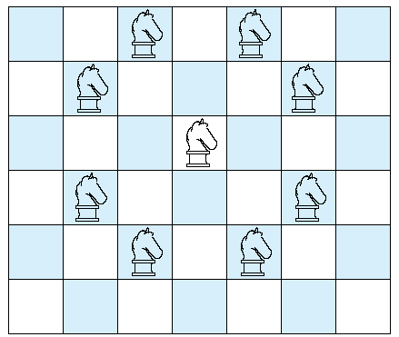
Fig 6.5 Legal moves of a chess knight.
Luger: Artificial Intelligence, 6th edition. © Pearson Education Limited, 2009
10

Slide 11
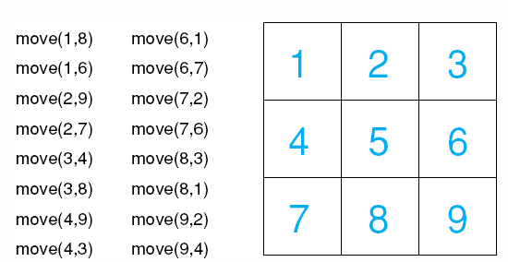
Fig 6.6 a 3 x 3 chessboard with move rules for the simplified knight tour problem.
Luger: Artificial Intelligence, 6th edition. © Pearson Education Limited, 2009
11

Slide 12
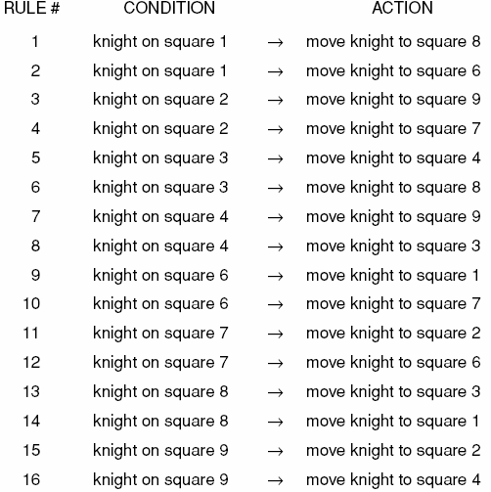
Table 6.1 Production rules for the 3 x 3 knight problem.
Luger: Artificial Intelligence, 6th edition. © Pearson Education Limited, 2009
12

Slide 13
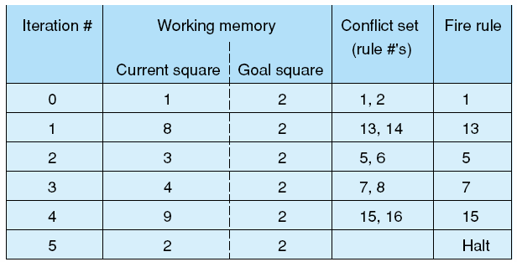
Fig6.7 A production system solution to the 3 x 3 knight’s tour problem.
Luger: Artificial Intelligence, 6th edition. © Pearson Education Limited, 2009
13

Slide 14
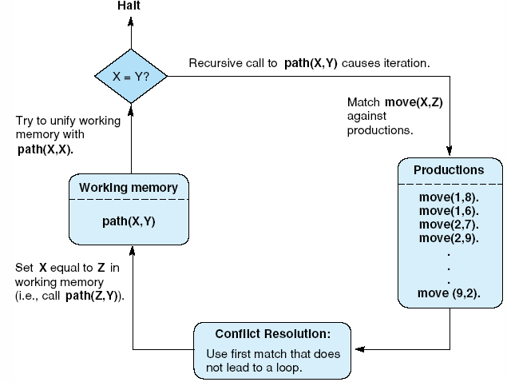
Fig 6.8 The recursive path algorithm as production system.
Luger: Artificial Intelligence, 6th edition. © Pearson Education Limited, 2009
14

Slide 15
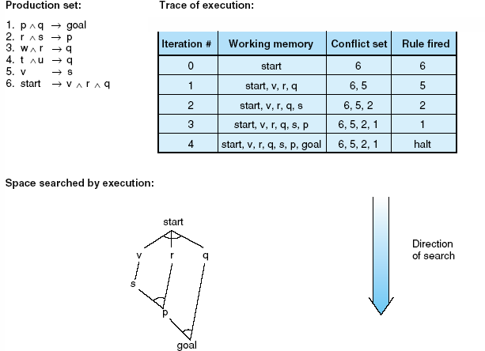
Fig 6.9 Data-driven search in a production system.
Luger: Artificial Intelligence, 6th edition. © Pearson Education Limited, 2009
15

Slide 16
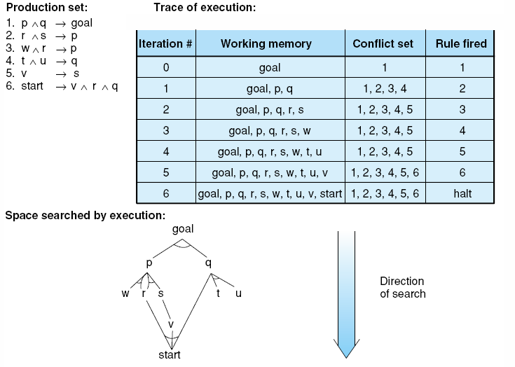
Fig 6.10 Goal-driven search in a production system.
Luger: Artificial Intelligence, 6th edition. © Pearson Education Limited, 2009
16

Slide 17
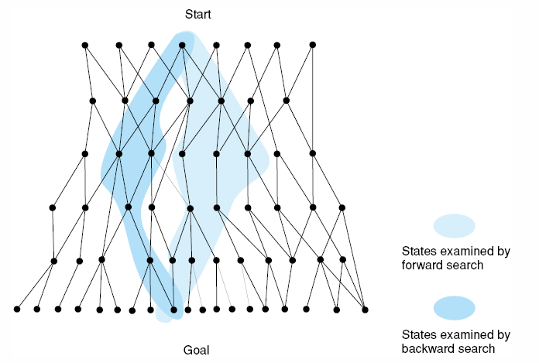
Fig 6.11 Bidirectional search missing in both directions, resulting in excessive search.
Luger: Artificial Intelligence, 6th edition. © Pearson Education Limited, 2009
17

Slide 18
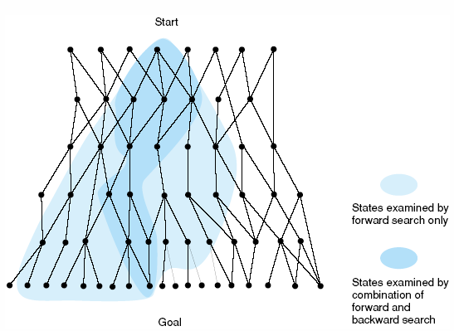
Fig 6.12 Bidirectional search meeting in the middle, eliminating much of the space examined by unidirectional search.
Luger: Artificial Intelligence, 6th edition. © Pearson Education Limited, 2009
18

Slide 19
Major advantages of production systems for artificial intelligence
Separation of Knowledge and Control
A Natural Mapping onto State Space Search
Modularity of Production Rules
Pattern-Directed Control
Opportunities for Heuristic Control of Search
Tracing and Explanation
Language Independence
A Plausible Model of Human Problem-Solving
Luger: Artificial Intelligence, 6th edition. © Pearson Education Limited, 2009
19

Slide 20
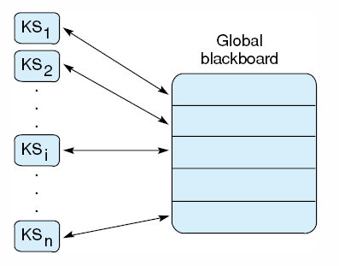
Fig 6.13 Blackboard architecture
Luger: Artificial Intelligence, 6th edition. © Pearson Education Limited, 2009
20

